Slide 1
Guide to developing digital security competence and culture v.2.0
VAHTI Good Practices support material
Notes:
DIGITAL AND POPULATION DATA SERVICES AGENCY

Slide 2
Contents of the guide
1 Introduction
  1.1 Why is it important to develop digital security competence?
  1.2 Areas of digital security
  1.3 Organisational and digital security culture
2 A roadmap for developing digital security competence and culture
  2.1 Current state of digital security culture
  2.2 Drafting and maintenance of instructions
  2.3 Personnel training
  2.4 Measurement and continuous development
  2.5 Monitoring
  2.6 Annual clock for developing digital security
3 Digital security ambassadors
4 Digitally Secure Life training module
5 Additional material

Slide 3
VAHTI Good Practices support material
This support material has been prepared for public administration organisations to promote secure work and activities. The VAHTI Good Practices support material is based on the recommendations compiled by the expert groups of the Finnish Public Sector Digital Security Management Board (VAHTI, https://dvv.fi/en/vahti-network) in the fields of risk management, continuity and preparedness, competence development, ICT services, information security and data protection. By complying with these recommendations, we also promote cybersecurity.
The VAHTI Good Practices support material is primarily intended for public administration organisations but it is also freely available to other organisations. If you develop or improve these materials, please also give feedback to help us develop the content. We welcome suggestions for improvements and corrections and will release an updated version once we have received sufficient feedback. You can send feedback to digiturva@dvv.fi – Title the message as ‘VHK digiturvaosaaminen’.
We advice you to modify the material for your own needs and not to publish or distribute the original version for the use of your organisation.

Slide 4
1 Introduction
Why is it important to develop digital security competence?
Areas of digital security
Organisational and digital security culture

Slide 5
1.1 Why is it important to develop digital security competence?
This guide is intended for all those who develop digital security competence and culture in an organisation such as specialists in digital security, ICT and HR as well as the management.
Even though the guide is primarily intended for organisations in the early stages of developing their digital security culture, it contains ideas for every organisation on how to develop its activities.
Well-managed digital security can be a selling point for an organisation or a statutory requirement for operations. If an organisation has problems with its digital security, it may suffer reputational damage and financial losses.

Slide 6
Every organisation possesses information that can be used for criminal financial gain or for planning or carrying out serious offences.
Ultimate responsibility for digital security always rests with the organisation’s management but each of us is responsible for ensuring its effectiveness as we make our daily choices. Most people also obey traffic rules, lock their doors and refuse to share their personal banking IDs or other personal details with strangers.
A person with good digital security competence acts in accordance with their organisation’s digital security guidelines, identifies the information and uses properly classified locations, equipment and services to process the data.

Slide 7
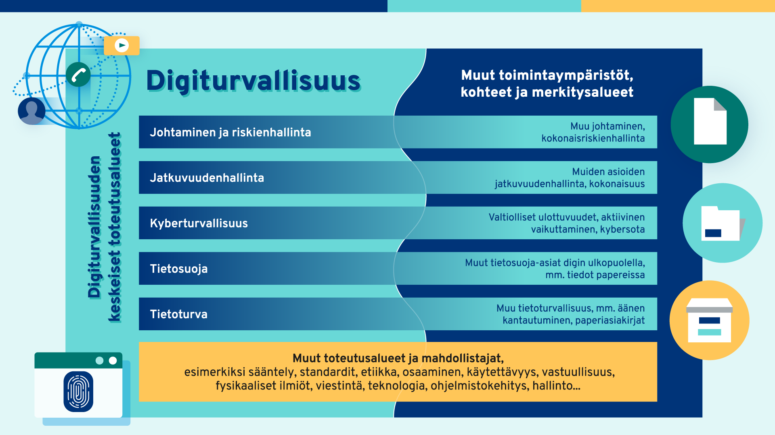
1.2 Digital security

Slide 8
Digital security – Management and risks
Implementing digital security requires organised activities and management as well as proper risk management procedures. Management of digital security should therefore be a natural part of the management, administration and overall security of the organisation. Security should not be a patch over deficiencies because such solutions do not work and they generate additional costs. All security-related operating models and controls should be built by design.
Risk management comprises the risk assessment process and the planning, implementation, monitoring and correction of the measures. Risk management is an essential part of proactive management and an organisation’s decision-making.
An example from the perspective of an organisation: The organisation’s operating methods are developed based on identified threats and opportunities.
An example from the perspective of an individual: Everybody can observe and identify risks associated with the use of digital services and manage them by acting in a careful manner.

Slide 9
Continuity management in digital security
Continuity management means preventing disruptions, preparing for them, recovering from them and managing their impacts, and ensuring the continuity of the organisation’s operations.
An example from the perspective of an organisation: An organisation safeguards its own operations or such matters as the security of supply by drawing up preparedness and continuity plans and plans for disruptions affecting its physical and digital operating environment.
An example from the perspective of an individual: Everybody can prepare for power failures or disruptions in water supply by keeping adequate supplies of food, water and medicines at home and by ensuring that they are able to use digital equipment during disruptions.

Slide 10
Digital security – Cybersecurity
Cybersecurity means the security of a digital and networked society or organisation. Its purpose is to safeguard the vital and critical functions of society or an organisation. In the NIS directive of the EU, cybersecurity refers to measures that are required to protect networks and information systems, users of such systems and other relevant persons against cyberthreats. Cyberthreats refer to potential situations, events or activities that can damage or interfere with networks and information systems, users of such systems and other persons or otherwise adversely affect them.
An example from the perspective of an organisation: Water and energy supply systems and telecommunications systems must be protected with particular care against disruptions and faults.
An example from the perspective of an individual: Everybody can protect themselves against information influence activities by taking a critical view of online content and by improving their own media literacy, and against cyber influence activities by ensuring the security of the digital equipment and services they use at home.

Slide 11
Digital security – Information security
Information security means the measures taken to ensure confidentiality, integrity and availability of data. The purpose of information security is to ensure that only the authorised parties have access to the information that they need, that the information cannot be altered unlawfully and that the information can be accessed when it is needed.
An example from the perspective of an organisation: An organisation must instruct that work tasks are only performed with the organisation’s equipment and the digital services that it has approved in the facilities in which the processing of such data is permitted.
An example from the perspective of an individual: Everybody can secure their own data by keeping the passwords of their digital equipment and services in a safe place, by using passphrases instead of passwords and by using multi-factor authentication.

Slide 12
Digital security – Data protection
Data protection is a fundamental right safeguarding a data subject’s rights and freedoms in the processing of personal data. The purpose of data protection is to show when and on what basis personal data may be processed. Processing of personal data must always be based on the law.
An example from the perspective of an organisation: Patient data must be handled carefully and in a secure manner to prevent outsiders from accessing it. Information security plays a key role in the implementation of data protection.
An example from the perspective of an individual: Everybody can take care of their own personal data by carefully considering what data they enter in digital services and by minimising the amount of data they enter in the services.

Slide 13
1.3 Organisational culture
Organisational culture is the system of internal values, norms, operating practices and other similar factors of a company or other organisation. It describes how a work community functions and how its members interact. Organisational culture is often shaped over time and it is built on the strategy work carried out by the company’s management and with the individuals at the workplace.¹² It may include the company’s operating models, management practices, customs, habits, values and the story of the organisation.¹
A good organisational culture can boost success because it creates an effective and innovative atmosphere in which everyone’s opinions count and matters are discussed.¹ Building the organisational culture requires continuous efforts and commitment to the company’s values and strategy.
  This text was produced with Microsoft Copilot AI.

Slide 14
1.3 Digital security culture
Digital security culture is part of the organisational culture and it describes how digital security is integrated into the organisation’s activities.
The practices may also be unwritten and they may be passed on from one employee to another.
In an organisation with good digital security culture, employees are allowed to communicate, encouraged to raise their hand if they have made a mistake, and thanked for reporting a matter.
An organisation can start the development of its digital security culture by creating risk management procedures and use them as a basis for information security and data protection policies. These can provide the foundation for guidelines and training. An information security policy is part of the organisation’s information security management system, which should at least describe the allocation of responsibilities, objectives and principles of the information security policy and the monitoring practices. It should be approved by the organisation’s management.
The digital security culture flourishes when the entire organisation is committed to its development. The organisation must ensure that the digital security guidelines are detailed, explaining why they must be complied with, and that they support daily work. This makes it easier for the employees to adhere to the guidelines.

Slide 15
2 A roadmap for developing digital security culture
In the development of the digital security competence, the management must be committed to the development work, set an example and provide the necessary support. This is important to ensure that the organisation has the resources to develop guidelines and training and to allocate time for studying them.
Management members are expected to serve as an example in compliance with the rules and guidelines.
Responsibility for the development of digital security competence should lie with a team supported by the management.

Slide 16
Development of digital security competence should start from the basic issues. The organisation should first identify its critical areas and the threats and risks facing them. This assessment should be used as a basis for information security policies, from which guidelines and training are derived.
Identify the development priorities and focus on them.
The following roadmap model can be used to support the development work:

Slide 17
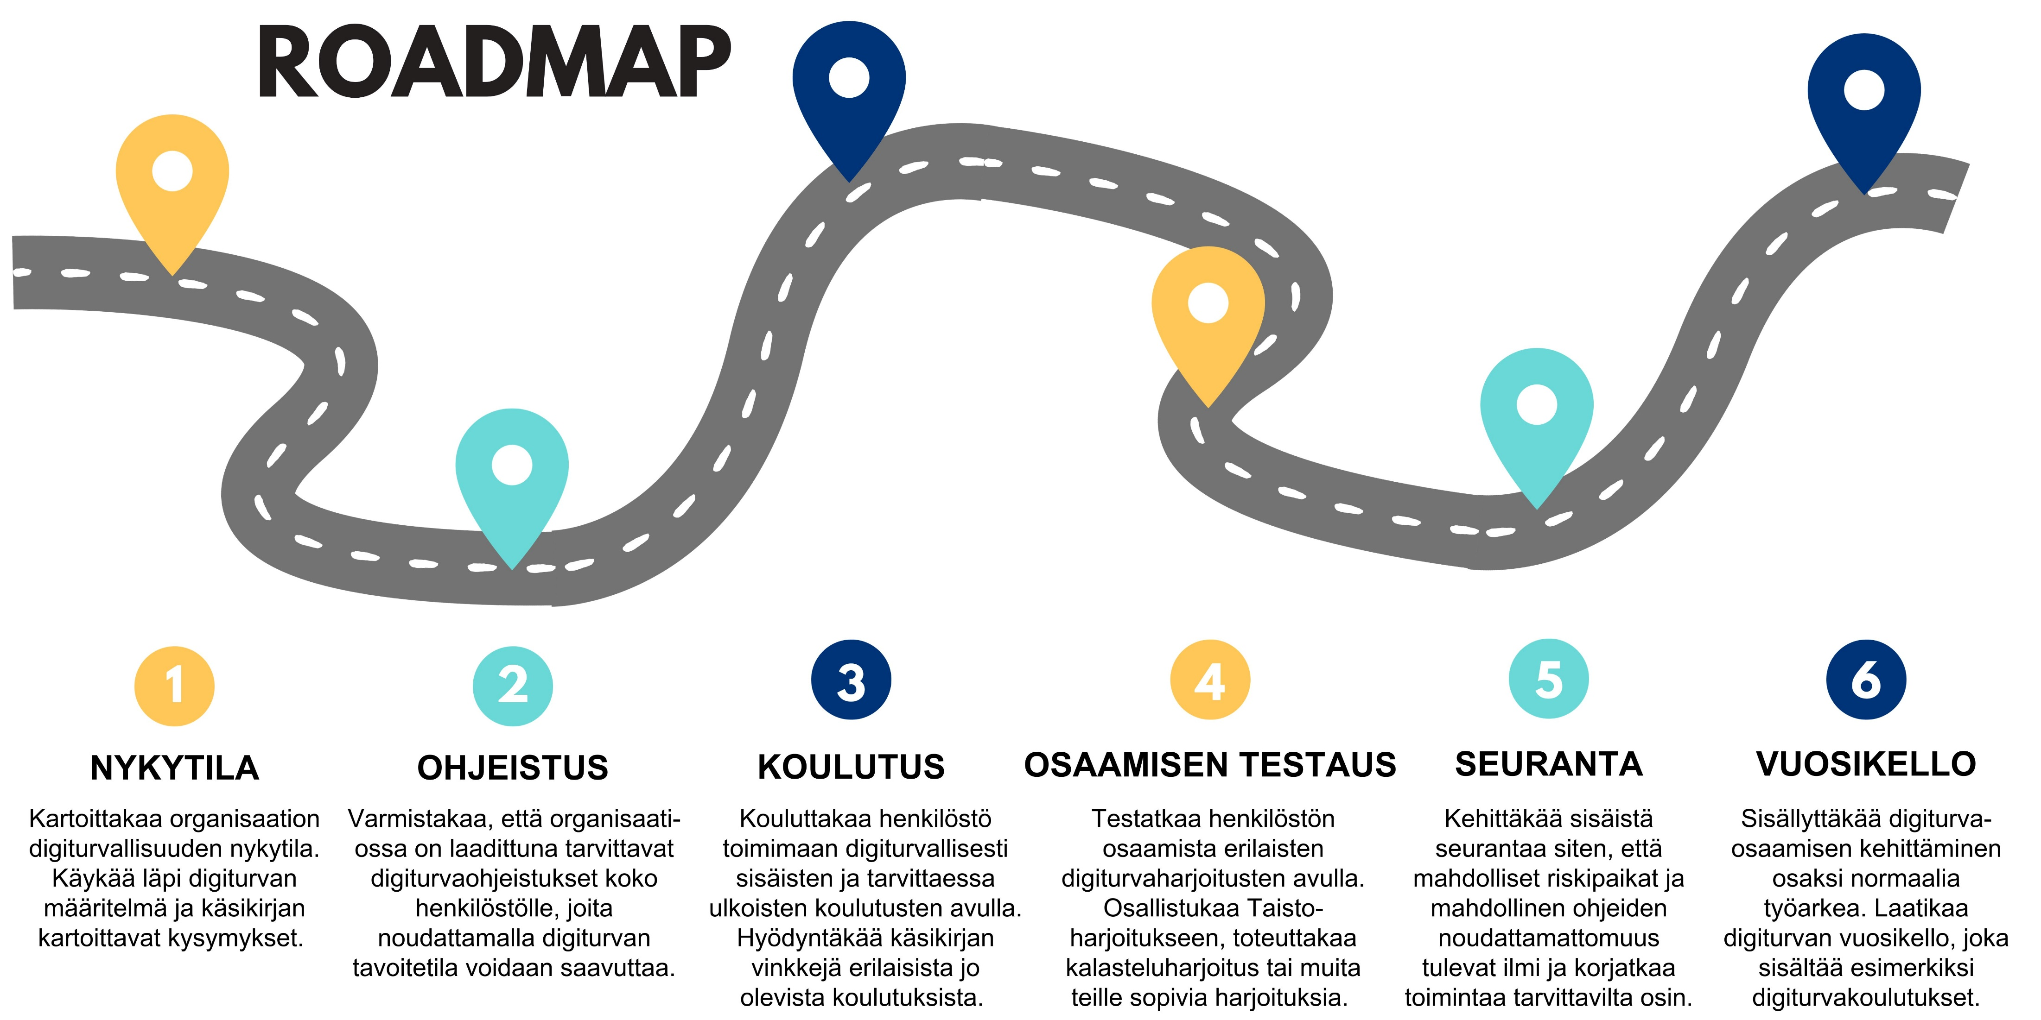

Slide 18
2.1 Current state of digital security culture
What is the current state of your organisational culture?
Has your organisation identified the areas in its operations that should be protected and identified the risks arising from them?
Has the organisation prepared an information security policy?
Has the organisation prepared digital security guidelines on the basis of its information security and data protection policies?
What are the weak and strong points in your organisation’s digital security competence?

Slide 19
Does your organisation provide training in digital security? Is the training provided on a regular basis?
Is the training provided in-house or is it outsourced?
Is digital security included in the familiarisation of new employees?
Have measures been taken to ensure that the employees understand the importance of digital security in their daily work?
Is training in preparedness and continuity themes provided?
Are digital security competence matters monitored and measured?
Are the instructions kept in one place that is easy to find?
Are the instructions in line with the organisation’s current policy documents?
Describe how the management has pledged to develop and promote digital security.

Slide 20
2.2 Drafting and maintenance of instructions
First identify the areas that should be protected and the risks arising from them.
Prepare information security and data protection policies that you can use as a basis for the required instructions.
Provide the employees with clear and easy-to-understand instructions for digitally secure work. Remember to explain why all this is necessary.
Make sure that the instructions are easy to find and that all essential matters are explained in them in a clear and easy-to-understand manner.

Slide 21
Make sure that at least the following themes are covered in the instructions:
  Classification of data
  Secure handling of information and secure processing of personal data, taking into account the data life cycle.
  Secure use of equipment
  Secure use of services
  Use of IDs and identification
  Working in facilities
  Remote work
  Travel
You can use the following websites to prepare the instructions:
  https://tietosuoja.fi/en/organisations
  https://www.kyberturvallisuuskeskus.fi/en/ncsc-news/instructions-and-guides
  https://dvv.fi/en/digitally-secure-life

Slide 22
Campaigns to boost digital security awareness
Campaigns should be organised to enhance digital security awareness among the employees. The focus in the campaigns should be on one or two matters, such as better passwords or identification of scam messages.
The campaign messages can be in the form of posters or
information bulletins on the intranet.
Prepare objectives and indicators for the campaigns.
The work should start with a situation assessment.
The message should be repeated in different forms for the whole duration of the campaign.
A situation assessment should also be conducted after the campaign.

Slide 23
2.4 Personnel training
Make sure that all employees receive internal training on an annual basis and as part of their familiarisation.
Also use existing material, such as the Digitally Secure Life training module https://dvv.fi/en/digitally-secure-life, monthly digiturvatunti-webinars of the Digital and Population Data Services Agency https://live.mediaserver.fi/dvv/digiturva (in Finnish), Yle Digitreeni programmes https://yle.fi/aihe/digitreenit/tietoturva (in Finnish) and other support material.
In addition to using training provided by specific actors (such as the Digital and Population Data Services Agency), you should also prepare organisation-specific training explaining how to act in the organisation (for example, how to send secure mail).
Training targeted at small groups is usually more effective.

Slide 24
Prepare tasks that encourage people to think and deal with everyday situations.
  You can use AI services in the drafting of questions and correct answers.
Monitor the progress of the training participants by using a HR system or other appropriate systems.
Some organisations may require that an employee completes basic training before they are allocated a work station or given personal IDs.

Slide 25
2.5 Testing competence
You should test your employees’ competence on a regular basis.
You can use the results of phishing message simulation, digital security quizzes and the Digitally Secure Life test as indicators. Digitally Secure Life test (eOppiva)
You should also take part in the annual Taisto exercise, in which the participants practice the management of disruptions on the basis of themes and topical issues that change each year.
  https://dvv.fi/taisto (in Finnish)

Slide 26
You can produce ‘phishing messages’ that resemble emails sent by cybercriminals and use them in the training.
Remember to notify other members of the organisation of such exercises in advance.
Use the test results in the development of instructions, training and campaigns.
The number of information security incident reports submitted by employees is not necessarily a good indicator. This is because as the digital security culture improves, such reports become more frequent, especially in organisations in the early stages of competence development.

Slide 27
2.6 Monitoring
Internal monitoring is an essential part of digital security competence development.
This is because with monitoring, you can identify development priorities.
Define the objectives and indicators for the development of digital security competence.
Also use the monitoring to ensure sufficient resources for the work. Sufficient resources are essential for ensuring digital security.
Monitor the progress of training participants and their test success.

Slide 28
2.7 Annual clock for developing digital security competence
Make the development of digital security competence part of daily work.
You can prepare an annual clock for digital security matters or include them in an existing annual clock.
At least the following matters should be considered when you prepare the annual clock:
  Annual policy review and update, and management approval
  Familiarisation
  Enhancing of digital security awareness
  Updating of digital security instructions
  Digital security training
  Competence testing
  Monitoring and reporting
  Disseminating information on topical digital security matters on a regular basis
    Table of examples is appended to this document (coming later)
  Practising (such as Taisto)

Slide 29
3 Digital security ambassadors
The digital security ambassador is an employee of an organisation tasked with promoting digital security culture in their organisation. However, the ambassador is not responsible for such matters as the organisation’s information security matters.
The digital security ambassador model is a way to develop an organisation’s digital security competence and culture and to ease the workload of the persons responsible for its digital security.
The model is primarily intended for public administration organisations but it can also be used in the business sector.
The model is suited for all areas of digital security.

Slide 30
3.1 Benefits of having a digital security ambassador
Digital security ambassadors support the practical implementation of their organisations’ information security and data protection policies by regularly disseminating topical information on information security and data protection and by answering questions asked by the personnel.
It is probably easier to approach the digital security ambassador than the persons responsible for the organisation’s digital security. Digital security ambassadors serve as a bridge between the employees and the persons responsible for information security and data protection, making it easier to integrate information security and data protection practices into all functions of the organisation.
Digital security ambassadors are used in the development of training and guidelines in the organisation and as a test group. This ensures that the training is easy to follow and suited for work tasks.
With the ambassadors, organisations can strengthen employees’ commitment to information security objectives, and the model also promotes a digital security-friendly organisational culture.

Slide 31
3.2 Designating the digital security ambassador
It is important to set clear goals for the ambassadors so that the effectiveness of their work can be assessed.
The effectiveness of the ambassadors can be measured by, for example, monitoring the results of phishing simulations, completion rates of digital security training and the reduction in the number of reported near misses.
The ambassador is provided with a communication channel, to which the persons responsible for the organisation’s digital security are also connected. When the ambassador is designated, they should be instructed to provide guidance that is in line with the organisation’s digital security policy. This is because the other members of the organisation trust their competence.

Slide 32
The network of digital security ambassadors serves as the primary contact point for information security incident reports. Simple reports are dealt with by the ambassadors while difficult cases are referred to digital security experts.
The ambassadors should be given clear instructions and responsibilities to ensure that they can act in an unambiguous and effective manner in the organisation.
A playbook should be prepared for the ambassadors, documenting the rules and instructions for the activities and ensuring that all parties follow the same practices.
In large organisations, digital security ambassadors represent all functions and groups so that the network has at least one ambassador from each group.
All cases handled by the ambassadors should be systematically reported via the organisation’s official channels so that the information can be managed on a centralised basis.

Slide 33
Interviews conducted with the candidates should be used as a basis for selecting the digital security ambassadors.
Clear guidelines and training should be developed for the ambassadors, defining the way in which they act and the principles guiding their work. These matters should be discussed separately with each ambassador.
The digital security ambassador activities should be launched with a KickOff event to create a team spirit for the network and to give direction for the activities.
Regular network meetings should be held and they should also be attended by the organisation’s digital security experts. The meetings discuss the state of the network and the participants are also briefed about the threats facing the organisation.
The ambassadors’ time use and any additional compensation should be specified.
The model should be piloted with a small target group before extensive introduction.

Slide 34
3.3 Issues to consider when the digital security ambassador model is introduced
Digital security ambassadors provide advice in accordance with the organisation’s information security and data protection policies to prevent the spread of incorrect practices in the organisation.
To ensure a correct situational picture, all incidents resolved by the digital security ambassadors should be reported in accordance with the organisation’s official operating model.
Digital security ambassadors should be provided with detailed information on which incidents are serious and require immediate action.

Slide 35
The organisation should specify the number of working hours that the persons designated as ambassadors may spend in their role and whether they receive any additional compensation for acting as ambassadors.
It should also be clearly determined which situations are the responsibility of the digital security ambassador and which cases should be handled by digital security experts.
It should be ensured that the ambassadors have sufficient responsibilities so that they can deliver significant benefits to the organisation.

Slide 36
4 Digitally Secure Life training module
Digiturvallinenelama.fi
Digitally Secure Life online training and Digital Bane or Digital Boon videos
Digitally Secure Life game
Digitally Secure Life test
Training
2019->
Coaching 2020->
Demonstration of competence 2023->

Slide 37
Benefits of Digitally Secure Life game and training
What?
Do not rush to open email attachments.
Why?
Malware can spread through email attachments
How?
How should organisations send secure mail? How should incidents be reported?
Digitally Secure Life

Slide 38
Digitally Secure Life website
https://dvv.fi/en/digitally-secure-life
All Digitally Secure Life content in one place
Order Digitally Secure Life stickers for your organisation
Download Digitally Secure Life posters for your organisation (Passwords and scam messages)
The website is available in Finnish, Swedish and English

Slide 39
Personnel training
Digitally secure working life ( available in Finnish, Swedish and English)
https://www.eoppiva.fi/en/courses/digitally-secure-working-life/
Operate safely in the digital world (available in Finnish, Swedish and English)
https://www.eoppiva.fi/en/courses/operate-safely-in-the-digital-world/
Data protection ABC + Data protection ABC 2020 (available in Finnish, Swedish and English)
https://www.eoppiva.fi/koulutukset/abc-of-data-protection-for-public-administration-personnel-2020/

Slide 40
Digital security for local government officials (available in Finnish, Swedish and English)
https://www.eoppiva.fi/en/courses/digital-security-for-local-government-officials/
Digital security for elected officials in wellbeing services counties (available in Finnish, Swedish and English)
https://www.eoppiva.fi/koulutukset/digital-security-for-elected-wellbeing-services-county-officials/
ABC of data protection 2 – deeper in data protection (available in Finnish, Swedish and English)
https://www.eoppiva.fi/en/courses/abc-of-data-protection-2-deeper-in-data-protection/
Security classified documents (available in Finnish, Swedish and English)
https://www.eoppiva.fi/en/courses/security-classified-documents/
Processing and protecting confidential information (available in Finnish and Swedish)
  https://www.eoppiva.fi/koulutukset/salassa-pidettavien-tietojen-kasittely-ja-suojaaminen/

Slide 41
Training for managers and digital security experts
Securing digital operations during incidents (available in Finnish, Swedish and English)
https://www.eoppiva.fi/koulutukset/securing-digital-operations-during-incidents/
Risk management in the digital world (available in Finnish, Swedish and English)
https://www.eoppiva.fi/koulutukset/risk-management-in-the-digital-world/
Organising digital security through architecture (available in Finnish, Swedish and English)
https://www.eoppiva.fi/koulutukset/organising-digital-security-through-architecture/
Julkri – Assess And Develop Information Security (available in Finnish, Swedish and English)
https://www.eoppiva.fi/koulutukset/julkri-assess-and-develop-information-security/

Slide 42
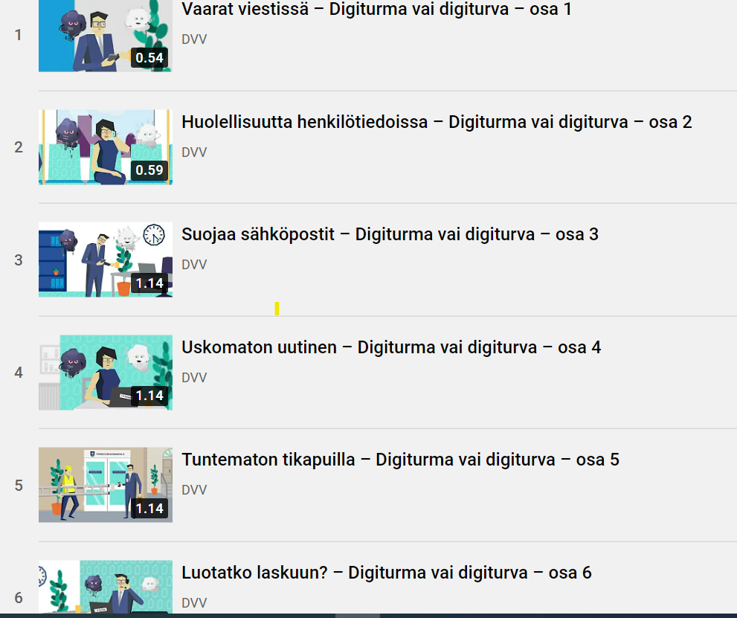
Digital Bane or Digital Boon (short videos)
This series of short videos provides you with the means to improve your everyday digital security both at work and in free time.
Learn how to identify digital security threats with concise and entertaining videos.
A moment’s thought determines whether you are going towards a digital bane or a digital boon.
Activate a handy playlist of 20 videos (The videos are in Finnish): https://youtube.com/playlist?list=PL1_-EIQ-Ddub-gVbetAX0qKVPhcdf-ar3

Slide 43

Digitally Secure Life game – your personal digital security exercise
Guide employees of the fictional municipality of Tyrskylä through ten days of digital security situations.
Two weeks and about 70 tasks have already been produced for the game.
This is an easy way to coach yourself or train your employees in digital security matters.
Available in Finnish, Swedish and English

Slide 44
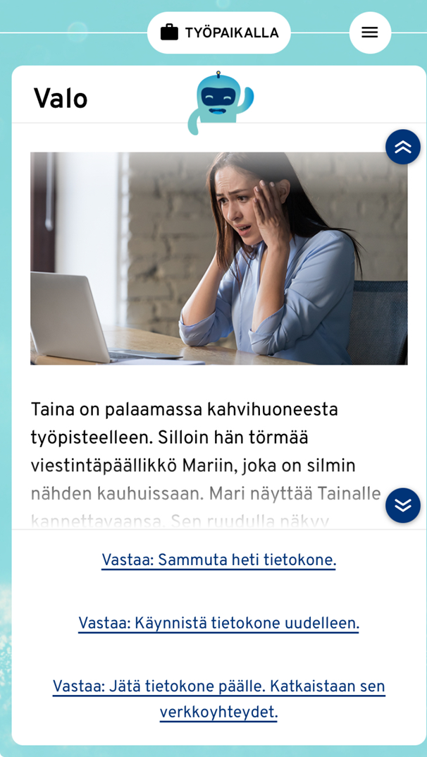
New week now available – Hijack in Tyrskylä!
You take the role of Tanja who has recently started as the information security manager of Tyrskylä municipality.
The themes of the week include risk management as well as operational, continuity and disruption management.
By playing the game, you learn more about the work of an information security manager. However, the game is not intended as a set of instructions, and you should also familiarise yourself with the guidelines issued by the National Cyber Security Centre.
In the middle of the week, something unexpected happens in the municipality of Tyrskylä. Download the game and find out.

Slide 45

Downloadable for iOS and Android devices
Google Play:
https://play.google.com/store/apps/details?id=fi.dvv.digiturvaelama
Appstore
https://apps.apple.com/app/id1514065267

Slide 46
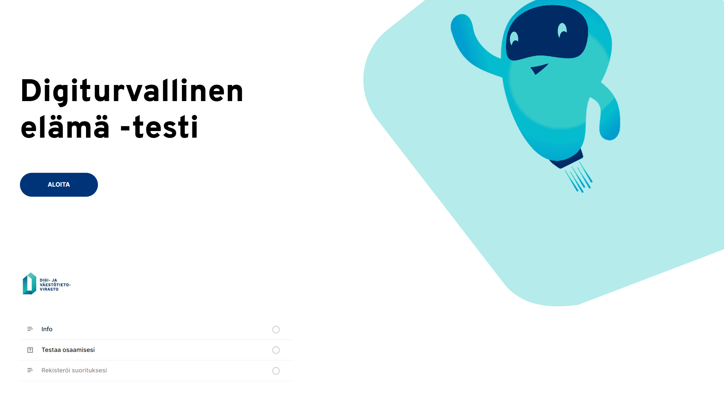
Digitally Secure Life test
A way to demonstrate your digital security competence.
After completing the test:
  You think about your work from the perspective of digital security.
  You pay attention to the classification of information and the use of facilities, equipment and services at work and in your free time.
  You are mindful of information security and data protection in communications.
  You are vigilant against scams and other cybercrime.
  https://www.eoppiva.fi/en/courses/digitally-secure-life-test/

Slide 47

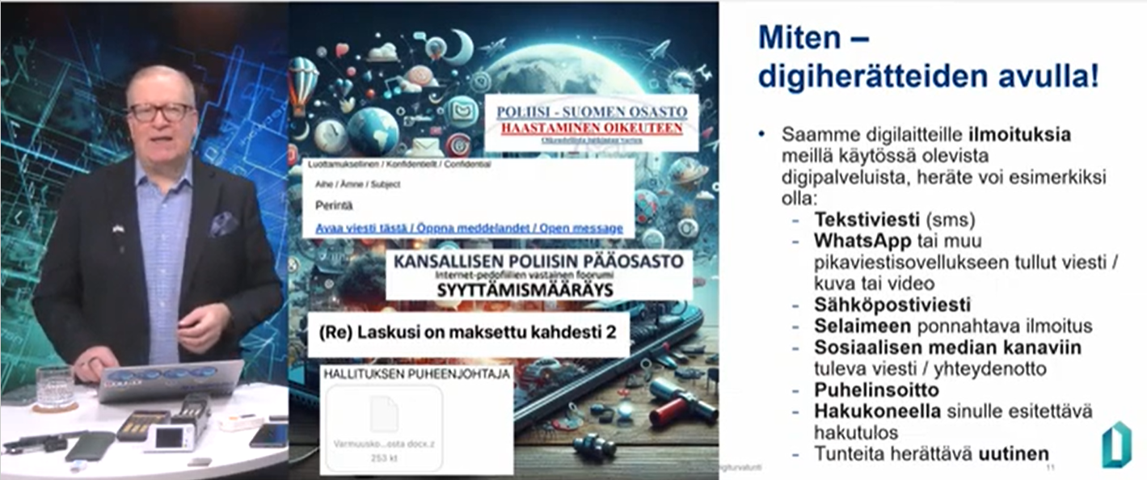
Take a look at the webinars offered by the Digital and Population Data Services Agency
Digital security events and webinars (in Finnish):
  https://dvv.fi/digiturvatilaisuudet
Webinar recordings:
  https://live.mediaserver.fi/dvv/archive

Slide 48
5 Additional material
Training, instructions, etc.
  Citizen’s cybersecurity (in Finnish): https://koulutuskalenteri.mpk.fi/Default.aspx?tabid=1054&id=155538#1a251873
  Yle Digitreenit
    https://yle.fi/aihe/digitreenit/tietoturva
  Instructions and guides issued by the National Cyber Security Centre: https://www.kyberturvallisuuskeskus.fi/en/ncsc-news/instructions-and-guides
  “Learn to recognise the most common scams and protect your data. If you have been scammed, it pays to act quickly and correctly, even if it is embarrassing – mistakes happen to everyone.”
  https://nytvalppaana.fi/en
  “SecPort is a cybersecurity portal designed to help all Europeans stay secure while using digital services and devices in their everyday life.” https://www.secport.org/
Games
  https://www.spoofy.fi/
  Cyber city tycoon: https://cyber-citizen.eu/secport-portaali-ja-cyber-city-tycoon-peli-julkaistaan-suomessa-31-10-2024/

Slide 49
Working group
VAHTI-OSKE group
  Joel Salmela, Istekki Oy
  Petri Vuorinen, Fimea
  Olli-Pekka Palonen, Prison and Probation Service of Finland
  Miia Kauppinen, Luovi Vocational College
  Juha Kirves, Digital and Population Data Services Agency
  Heidi Wallenius, Terveystalo
  Marica Lonka, National Audit Office of Finland

Slide 50
Notes:
DIGITAL AND POPULATION DATA SERVICES AGENCY

